Slide 1
Cross Entropy Method and BFGS for Optimization of 2-Dimensional Bonded-Molecule Clusters
Zaymon foulds-cook

Slide 2
Abstract
This paper defines a real coded implementation of the Cross Entropy Optimization Method as both a local and global optimizer in order to find optimal low energy configurations of bonded 2-dimensional molecules. The algorithm was able to find optimum and near optimum values for molecules of up to length 20 and found configurations within 5-15% of the optimum for larger molecules up to a length of 55.

Slide 3
High Level Overview (CE)
Generate a sample of random data according to some mechanism.
Score the sample and take an elite sub-sample of the resulting population.
Use the values of the elite sub sample to update the parameters of the random mechanism to produce a "better" sample on the next iteration.
The random mechanism can be as simple as specifying a parametric family of random distributions of the same length as the vector to be optimized (in this case the vector of angles) where the mean and standard deviation of each element in the parametric family are changed to reflect the elite sample after each generation.

Slide 4
High Level Overview (CE + BFGS)
An experiment to use the Cross Entropy Method as the global optimizer in order to generate optimization candidates for BFGS. Conceptually this method will allow the Cross Entropy Method to optimize the distribution vector to generate good candidates for BFGS optimization.
Generate Population using distribution vector.
Run BFGS on population members, generating an additional optimized population.
Calculate the scores of the optimized population and sort.
Update the distribution vector based on the pre-optimized sequences which correspond to the sequences in the elite sample of the optimized population.
Go to step 1.

Slide 5
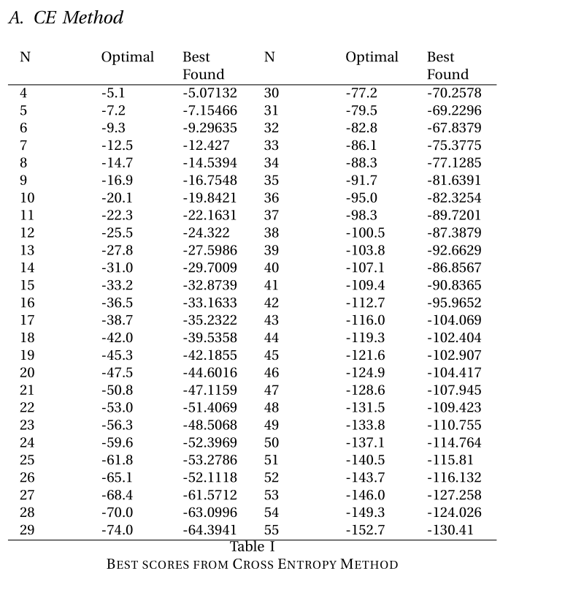
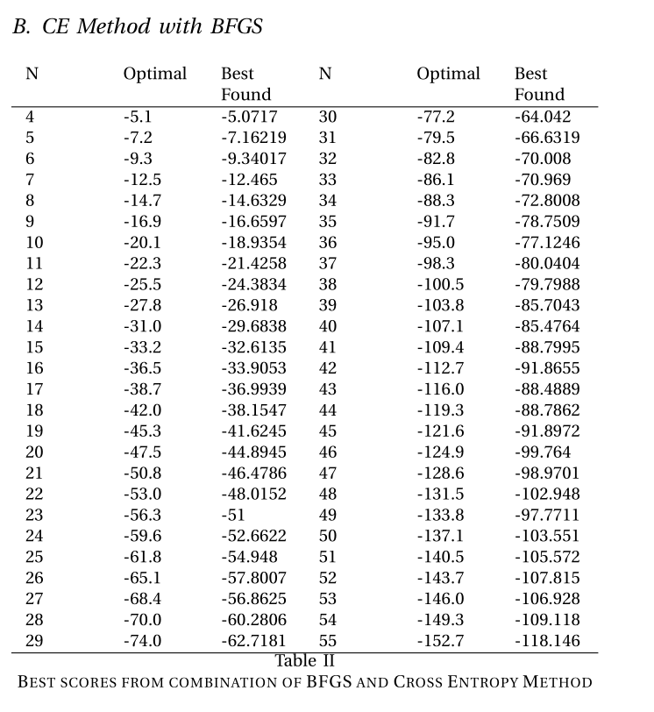
Results

Slide 6
Conclusion
Although the Cross Entropy Method (both as a local and global optimizer) was an ideal candidate to apply to the Bonded-Molecule problem the lack of ability to perform minima hopping in this implementation resulted in the algorithm not finding global minima for many lengths of molecules.

